Slide 1

Cs 429:DATA MINING Lecture 13
Instructor:
Osama Ahmed Khan
osamaahmedkhan
Jul 13th, 2017

Slide 2
Algorithms
Inferring Rudimentary Rules
Statistical Modeling
Divide-and-Conquer: Constructing Decision Trees
Covering Algorithms: Constructing Rules
Mining Association Rules
Linear Models
Instance-Based Learning
Clustering

Slide 3
Mining Association Rules
Default Method:
All possible combinations of Attribute-Value Pairs
Pruning of Rules on basis of Coverage and Accuracy
Attribute-Value Pairs = Items
Combinations = Item Sets

Slide 4
Mining Association Rules
Default Method

Slide 5
Mining Association Rules
Default Method

Slide 6
Mining Association Rules
Efficient Method:
Combinations of Attribute-Value Pairs with Pre-specified Minimum Coverage
Rules with Pre-specified Minimum Accuracy
Coverage = 2
Accuracy = 100%
Five-item sets = ?

Slide 7
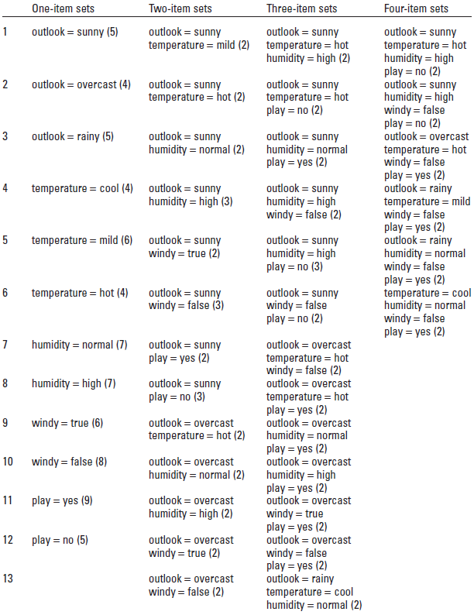

Slide 8
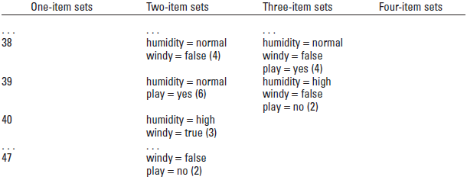

Slide 9
Mining Association Rules
Efficient Method
A Three-item set:
Rules:
Last Rule?
humidity = normal, windy = false, play = yes (4)
If humidity = normal and windy = false then play = yes
If humidity = normal and play = yes then windy = false
If windy = false and play = yes then humidity = normal
If humidity = normal then windy = false and play = yes
If windy = false then humidity = normal and play = yes
If play = yes then humidity = normal and windy = false
If - then humidity = normal and windy = false and
play = yes
4/4
4/6
4/6
4/7
4/8
4/9
4/14

Slide 10
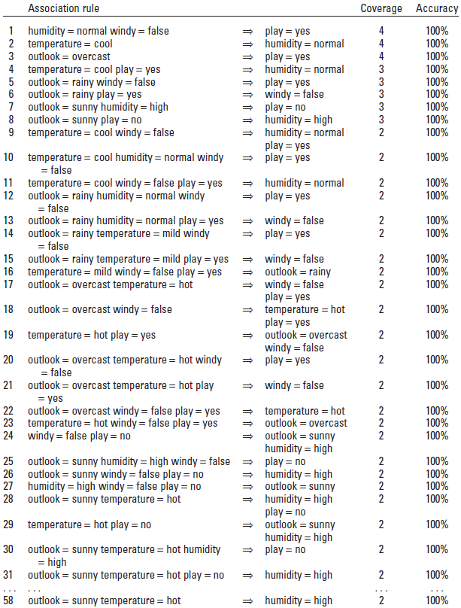

Slide 11
Mining Association Rules
Efficient Method
Consequent Conditions = 2 (7)
Consequent Conditions = 3 (0)
n-Item set’s Minimum Coverage =
All (n-1)-Item subset’s Minimum Coverage
Coverage | Rules
4 | 3
3 | 5
2 | 50

Slide 12
Mining Association Rules
Usage:
When attributes are binary
When data is sparse

